Slide 1



Class: IX Lab: 13
Python
Conditional Logic

Slide 2


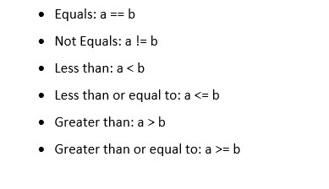
Basic Statements
Use these sign for
creating statements

Slide 3
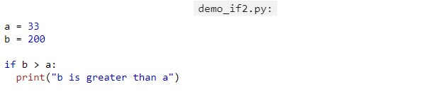

IF
The basic of If
Statements

Slide 4
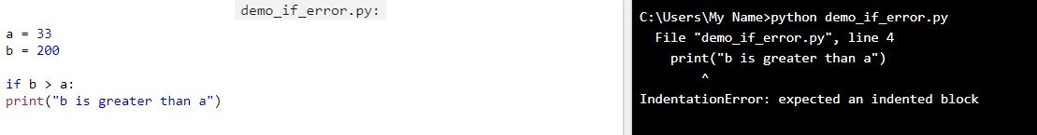
Indentation
If your indentation is not correct your program will not work

Slide 5
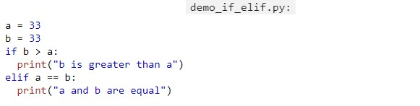

Elif
Use elif for
Creating more than one statement

Slide 6
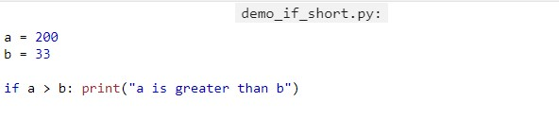
Short Hand If
You can use short hand format to declare a statement

Slide 7
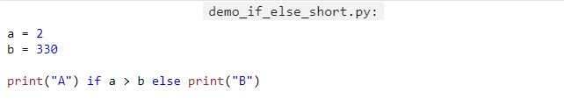

Short Hand If… Else
If… Else statement can also be used as short hand format

Slide 8
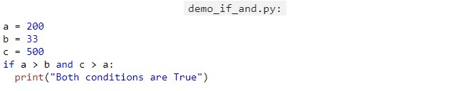

And
and is used to combine conditional statements

Slide 9
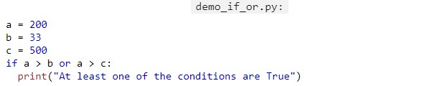

Or
Or is also used to combine operator

Slide 10
